Slide 1
“Strike The Balance” When School Expectations and Students’ Abilities Collide
David L. Gleason, Psy.D.
Montessori Accreditation Council for Teacher Education
Annual Symposium
Alexandria, Virginia
December, 2015

Slide 2
Some Intro …
Covey Story
David Elkind
Summer, 1995
A Celebration of Discovery!

Slide 3
Fundamental Concepts
“Technical vs. Adaptive Challenges” Ron Heifetz. M.D.
- INformative vs. TRANSformative Learning
- Most Common Error: Trying to solve “adaptive challenges” with “technical solutions.”
“LD/ADHD” vs. “Development”
- Marci vs. Toni
- Appearance of resolution (“She has ADHD,” or “She’s depressed”) sometimes gets adults “off the hook”
“Diagnosis & Treatment”
- Many medical Dx’s lead naturally to “technical treatments” but not all! Most, if not ALL mental health/education-related Dx’s require ongoing “adaptive responses” that necessarily involve reciprocal interactive patterns btw individual and environment.

Slide 4
Baseline TOVA – “Marci”

Slide 5
Challenge Dose TOVA – “Marci” (10mg Ritalin)

Slide 6
Challenge Dose TOVA – “Marci” (15mg Ritalin)

Slide 7
BDI-II, Toni…

Slide 8
BDI-II, Toni…

Slide 9
Manifestations of PRESSURE Prototypical Examples from Clinical Practice
1.) 10th grade Brian faces the Discipline Committee for getting caught drinking
2.) 11th grade Jonathan describes his pattern of “a slow build-up of anger,” without any real awareness of his escalating feelings, until it is too late…when he “explodes” by punching and putting a whole in a wall, injuring his hand and reporting, “but that was better than cutting…”
3.) High achieving 10th grade Melissa carves “I SUCK” in her arm.
4.) 9th grade Michael takes an overdose of Tylenol intending to end his life.
5) 11th grade Tara struggles with chronic depression and bulimia.
6.) 10th grade Lizzy commits suicide in February, 2009

Slide 10
“Things Aren’t Always What They Seem to Be…”

Slide 11
“Things Aren’t Always What They Seem to Be.” How do we know??
Anxiety/Depression
Learning Disorders
ADHD

Slide 12
“Striking The Balance?” When Expectations (“pressures”) & Abilities (“development”) Collide
Institutional, Parental, Social and Self-Imposed
Expectations/Pressures
Neurological
ADHD/LD
Developmental Capacities and Readiness?

Slide 13
Lessons from Developmental Theory
1896 – 1980
1902 – 1994

Slide 14
Lessons from Developmental Theory
Puberty’s role in triggering a rapid and simultaneous progression of physical, sexual, cognitive and emotional changes – WHY?
2nd major “sensitive period” of the human lifespan; highly vulnerable and susceptible to environmental influences
Jean Piaget: “Formal Operations” abstract hypothetical reasoning; “what might be?”
Erik Erikson: “Identity vs. Role Confusion” - “an end of childhood,” “a crisis of wholeness,” search for “progressive continuity.”
- “Persistent efforts to define, overdefine and redefine themselves” in an effort to avoid “the horror of undefinedness”

Slide 15
And from … Physician, Educator, and Innovator !!!

Slide 16
Maria Montessori 1870 – 1952
“Montessori Method”
- allows children to develop at their own pace
- learn through activities that involve exploration, manipulations, order, repetition, abstraction, and communication
- older children deal with abstract concepts based on their newly developed capacities for reasoning, imagination, and creativity

Slide 17
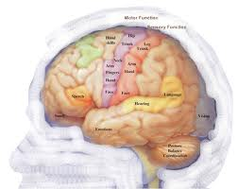
But Now … Unprecedented Lessons from Neuroscience

Slide 18
“Teen brains…are doing just what they should be doing!” Jay Giedd, M.D. (2012)
Limbic System Development
Prefrontal Cortex Development

Slide 19
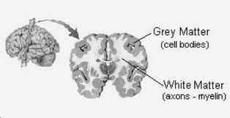
Brain matures by becoming more “connected” (white matter), not larger (grey matter)
“Neurons that fire together….” (Donald Hebb, Ph.D., 1949)

Slide 20
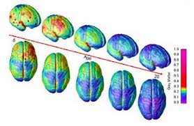
Time Lapse Brain Maturation Ages 5-20 (reflects 52 brains, each scanned 4 times between ages 5-20) Jay Geidd, M.D

Slide 21
Brain Maturation Time Lapse Photography (Jay Geidd, M.D.)

Slide 22
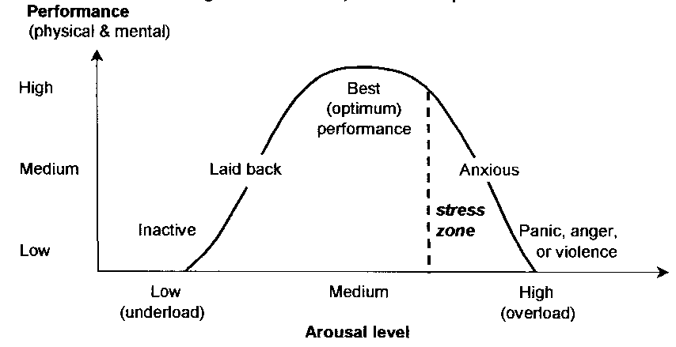
Performance/Anxiety Relationship (Yerkes-Dodson Law, 1908)
Notes:
Stress arises when the combination of internal and external pressures exceeds the individual's resources to cope with their situation. Stress may develop from chronic (ongoing) or acute (sudden) pressures.
Once stress exceeds the individual's ability to cope it results in a series of dysfunctional physical and mental responses. These can result in temporary or longer-term disruption of health and, ranging from impaired decision making to Post Traumatic Stress Disorder, and from disturbed digestion to ulcers and heart disease.

Slide 23
Adolescent Depression Neurobiological Framework (Andersen, L. & Teicher, M. 2008)
Lifetime prevalence increases from 1% of population under age 12 to 17%-25% in adolescence, particularly in females.
Anxiety usually precedes emergence of Depression.
For youth, Depression manifests as irritability, anhedonia, decreased concentration, hypersomnia and suicidality…without overt sadness, as usually seen in adults.
Suicide before age 10 is rare, but increases 100-fold between 10 and 14 years, and increases an additional 10 times between ages 15 and 19. WHY??
1. Typical adolescent changes in brain maturation
2. Window of vulnerability: “sensitive period” when specific regions of the developing brain are maximally sensitive to environmental influences.

Slide 24
Adolescent Depression Neurobiological Framework (Andersen, L. & Teicher, M. 2008)
PFC’s primary role to modulate activity of the limbic structures (Amygdala and Hippocampus)
Amygdala plays a primary role in mood regulation, is over-responsive to fearful stimuli in depression, and is insufficiently regulated by PFC controls.
Triadic Model: adolescent depression emerges as limbic structures driving affect are overwhelmed or mature in advance of PFC structures that provide regulatory/inhibitory control. (Ernst, M. et al. 2006)

Slide 25
School Pressure: An Adaptive Challenge

Slide 26
School Pressure: An Adaptive Challenge

Slide 27
Pressures…in the Extreme!

Slide 28
PRESSURE from “Culture & Society”
In our schools, students try to conform to tough expectations and adhere to rigorous (narrow?) academic pathways as if obligated…AND schools participate in, and comply with these widespread conformity efforts
Monoculture Effect: F.S. Michaels
a. From the practice of planting crops with the same patterns of growth resulting in genetic similarity
b. Socio-economic monoculture: “when dominant ideas arise, grab hold of our imaginations and shape our lives”
(competition; individual achievement at all cost; AP & IB accelerated courses; education is “monetized” and becomes “transactional;” oriented toward “across-the-board-greatness,” jobs and profession)
c. From “inside a monoculture, we (and our students) accept its definition of reality”
d. “An invisible foundation that structures and shapes our lives, giving us a sense of how the world works”

Slide 29
The Result: “Here & Now vs. There & Then”
At the dawn of their adolescence, rewarded for their achievements to date with an acceptance to a selective secondary school, many students encounter a distortion of the very rationale that got them there in the first place – that “hard work and good grades pay off!”
For many of these students, the hard work of “then” isn’t enough to pay off “now.”
Suddenly, their learning – the reason they matriculated originally – gets smothered by a host of relentless pressures and a “success at any cost” mindset, itself an anxiety that robs students of their “here and now” energy as they hyper-focus on “there and then.”

Slide 30
PRESSURE from “Executive Function” Demands…
Executive Functions Origins: Phineas Gage
Overtime, EF’s have been referred to as “the CEO” of the brain – primarily associated with the Prefrontal cortex (PFC)
Set of regulatory capacities that “cue the use” of various cognitive, emotional and social faculties
Normal Developmental Variation, with emphasis on “the big four:” organization, task initiation, time management and emotional regulation

Slide 31
PRESSURE on ALL our students…
ALL our students are developmentally vulnerable.
ALL our students are expected to “perform” in these sophisticated and competitive arenas.
When expectations exceed developmental capacities and associated coping skills…ALL our students get anxious.
Serious implications for academic success, mental health…and brain development.

Slide 32
So…keep in mind….
“The brain is the ultimate scientific authority.” David Elkind, 2007
“WE are responsible for the cultures WE create.” Dan Garvey, 1996
“It's sort of unfair to expect [teens] to have adult levels of organizational skills or decision making before their brains are finished being built.” Jay Geidd, M.D.

Slide 33
Contact Information
Telephone: 978-369-5036
Email: contact@drdavidgleason.com
Website: www.drdavidgleason.com

